Slide 1
Chapter Six
Data Communications and Computer Networks
CS211 ICT Fundamentals

Slide 2
Agenda
Data Communications
Data transmission
Communication channels
Types of transmission mode
Components of Data communications
Applications of Data Comm.
Computer Networks
Classification of networks
Networking components (devices, software, …)
Distributed systems
Notes:
Data processing (computers) and data communications
(transmission and switching equipment).

Slide 3
Data Communications
Communications, also called telecommunications, refers to the transfer of data from a transmitter (sender or source) to a receiver across a distance. The term telecommunication means communication at a distance. The data transferred can be voice, sound, images, graphics, video, text, or a combination thereof (multimedia).
Transmitter
Receiver
Information channel
Notes:
Data communications deals with the transmission of
signals in a reliable and efficient manner.
Information Channel = transmission media

Slide 4
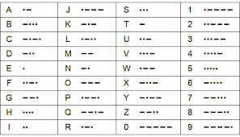
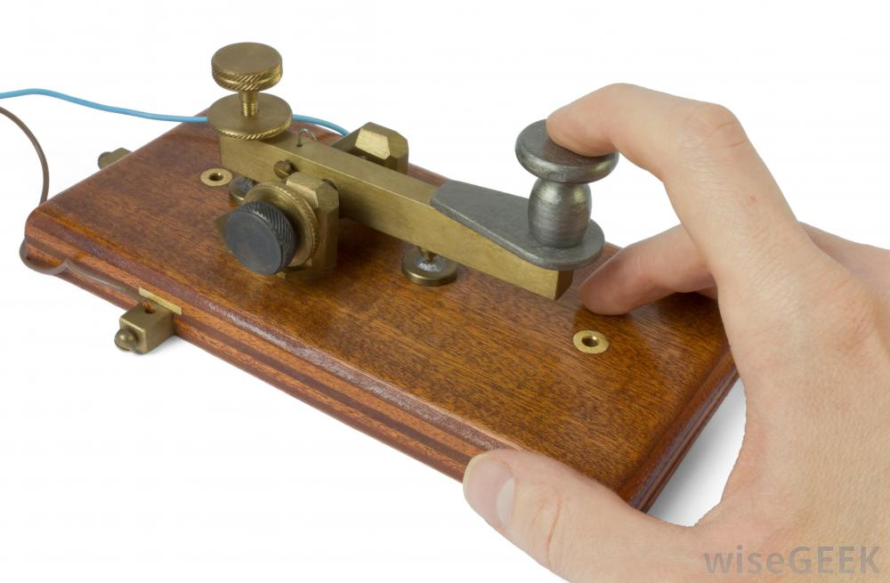
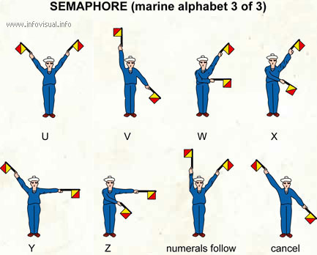
Telecommunications
Tele (Far) + Communications
Early telecommunications
smoke signals and drums
visual telegraphy
(or semaphore in 1792)
Telegram and telephone
Telegraph (1839)
Telephone (1876)
Radio and television
Telephony (VoIP)
Voice and Data
telegraph-machine
What is the medium here?
Notes:
Telegraph is a coded message sent by making and breaking an electrical connection.
PSTN (public switched telephone network) is the world's collection of interconnected voice-oriented public telephone networks, both commercial and government-owned. It's also referred to as the Plain Old Telephone Service (POTS).
A telegraph message sent by an electrical telegraph operator or telegrapher using Morse code (or a printing telegraph operator using plain text) was known as a telegram.
VoIP (voice over IP) is the transmission of voice and multimedia content over Internet Protocol (IP) networks. VoIP is enabled by a group of technologies and methodologies used to deliver voice communications over the internet, enterprise local area networks or wide area networks.

Slide 5
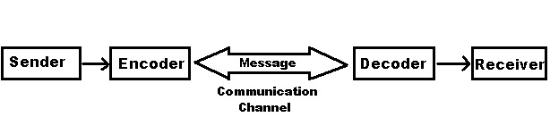
Data Communications
The word data refers to information presented (encoded) in whatever form is agreed upon by the parties creating and using the data.
Data communications are the exchange of data between two devices via some form of transmission medium such as a wire cable.

Slide 6
Communications Cont…
Data Communications
Transmission of signals
Encoding (conversion, encrypting, modulating…), interfacing (modulating,…), signal integrity, multiplexing, compression, etc.
To be transmitted data must be converted to electrical or electromagnetic signals.
The methods include electrical signals carried along a conductor, optical signals along an optical fiber, and electromagnetic signals (waves) through space
The two measure approaches to greater efficiency in using a shared medium for data communication are multiplexing and compression.
Notes:
Multiplexing is simultaneous transmission of several signals along a single high speed channel of communication.
Interface is a device or program for connecting two items of software or hardware. Example NIC, modem
Encoding: Converting in to a coded form
Signal Integrity: The state of being whole; Not corrupted during transmission
Using frequency division multiplexing (FDM), a coaxial cable can carry over 10,000 voice channels simultaneously.
Coaxial cable is used to transmit both analog and digital signals.

Slide 7
Data communication four basic terms
Data: A collection of facts in raw forms that become information after processing.
Signals: Electric or electromagnetic (radio and light waves) encoding of data.
Signaling: Propagation of signals across a communication medium.
Transmission: Communication of data achieved by the processing of signals.
Notes:
Data as entities that convey meaning, or information.
Signals are electric or electromagnetic representations of data.
Signaling is the physical propagation of the signal along a suitable medium.
Transmission is the communication of data by the propagation and processing of signals.
Propagation = Broadcast

Slide 8
Analogue & Digital Signals
Telephones, radios, and televisions – The older forms of communications technology – were designed to work with an analog signal.
An analog signal is a continuous electrical signal in the form of a wave. The wave is called a carrier wave.
Two characteristics of analog carrier waves that can be altered are frequency and amplitude.
Examples of analog values: Sound, Temperature, Pressure, Light, Video
Notes:
For long-distance transmission of analog signals, amplifiers are needed every few kilometers, with closer spacing required if higher frequencies are used. The usable spectrum for analog signaling extends to about 500 MHz. For digital signaling, repeaters are needed every kilometer or so, with closer spacing needed for higher data rates.
Some transmission media, such as optical fiber and unguided media, will only propagate analog signals.

Slide 9
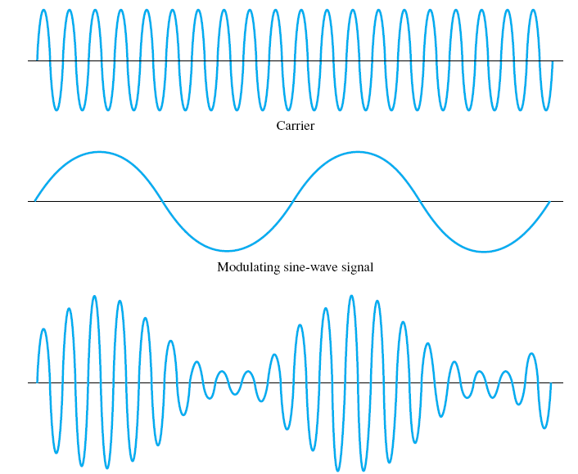
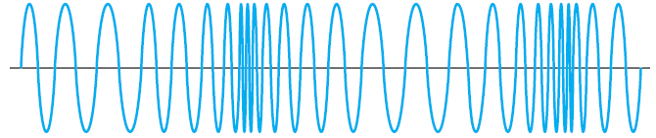
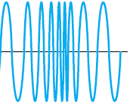
Analogue & Digital Signals Cont.
Carrier
Modulating sine-wave signal
Processing of signals for transmission
Amplitude-modulated wave
Frequency-modulated wave
Notes:
Digital signals are relatively easy to store and manipulate electronically.

Slide 10
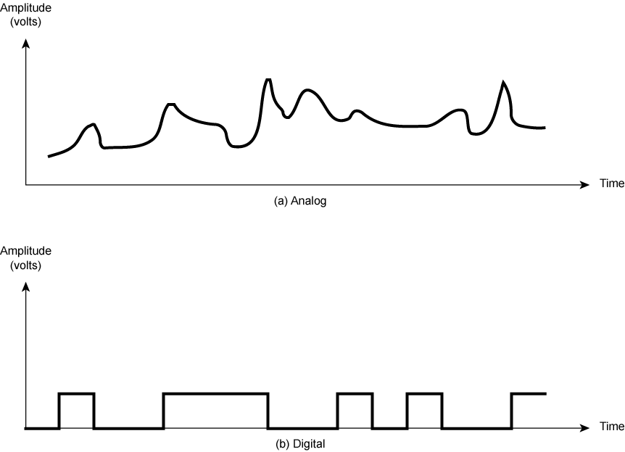
Analogue & Digital Signals
Continuous values within some interval
e.g. sound, video
Detecting and correcting distortion due to noise (introduced during transmission) is relatively easy in digital transmission
Discrete values
e.g. text, integers
The principal advantages of digital signaling are that it is generally cheaper than analog signaling and is less susceptible to noise interference.
Notes:
Attenuation:
1st and 1,000,000th copy of a CD are the same, but using analog …

Slide 11
Bandwidth of transmission
telecommunications: range of radio frequencies: a range of radio frequencies (hertz) used in radio or telecommunications transmission and reception.
computing: communications capacity: the capacity of a communications channel, for example, a connection to the Internet, often measured in bits per second (bps).
a data transmission rate; the maximum amount of information (bits/second) that can be transmitted along a channel. Higher frequency and/or wider bandwidth results in transmission of more data per unit time. (bus speed, serial & parallel ports)
Bandwidth is limited by the type of transmission medium
Notes:
Any electromagnetic signal, analog or digital, is made up of a number of constituent frequencies. A key parameter that characterizes the signal is bandwidth, which is the width of the range of frequencies that comprises the signal.
In general, the greater the bandwidth of the signal, the greater its information-carrying capacity.
The Data rate is limited by the bandwidth, the presence of impairments, and the error rate that is acceptable.
In telephone networks, this frequency band typically has a width of 4 kHz.
The width of the band is called, not surprisingly, the bandwidth. FM radio stations also use FDM to
share microwave frequency spectrum.

Slide 12
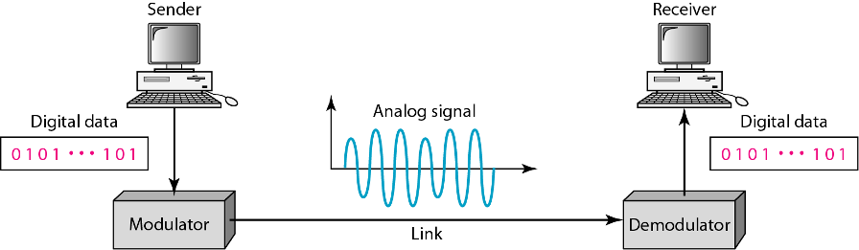
Digital-to-Analog Conversion
Required to send digital data over a public telephone channel
Also known as modulation
(telephone channel)
What are telecommuting and virtual offices?
“Move the work instead of the workers”
Notes:
Some transmission media, such as optical fiber and unguided media, will only propagate analog signals.

Slide 13
Devices of Data Communication
Video Display Terminals and printing terminals
I/O devices (microphones, speakers, cameras, etc.)
Modem – transmission of data over telephone lines
Interface units (modems, multiplexers, codecs) - Coordinates various types (aspects) of data transmission and receptions. Thereby greatly increasing the efficiency of data communication.
An analog communication device always distorts the input and adds noise.
Digital information doesn’t become distorted while being stored, copied, or communicated.
Notes:
Communication channels
Pathways over which data are sent
Data links, info. Channel, comm. lines
Communication software

Slide 14
Data transmission
A basic communication system consists of :
Example - consider a radio broadcast.
In this case
the broadcast tower (antenna) is the transmitter,
the radio is the receiver and
the transmission medium is free space.
Transmitter
Receiver
Information channel
Notes:
Often telecommunication systems are two-way and
devices act as both a transmitter and receiver or transceiver.
For example, a mobile phone is a transceiver.

Slide 15
A Communications Model
Source
generates data to be transmitted
Transmitter (some encoding is done here)
Converts data into transmittable signals
Transmission System
Carries data
Receiver (decoding…)
Converts received signal into data
Destination
Takes incoming data
Notes:
A model is a simplified form of a complex reality.

Slide 16
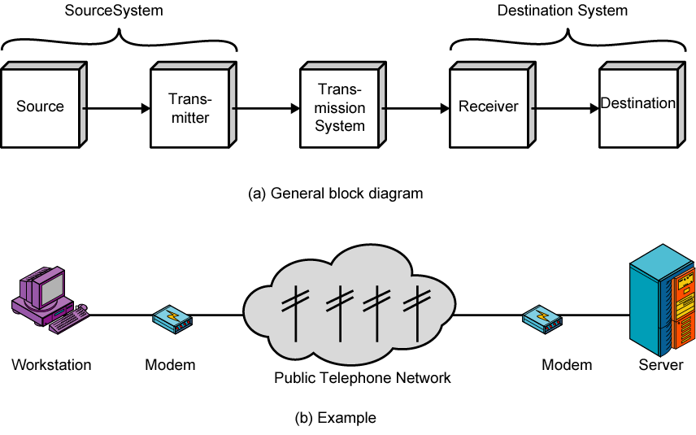
Simplified Communications Model - Diagram

Slide 17
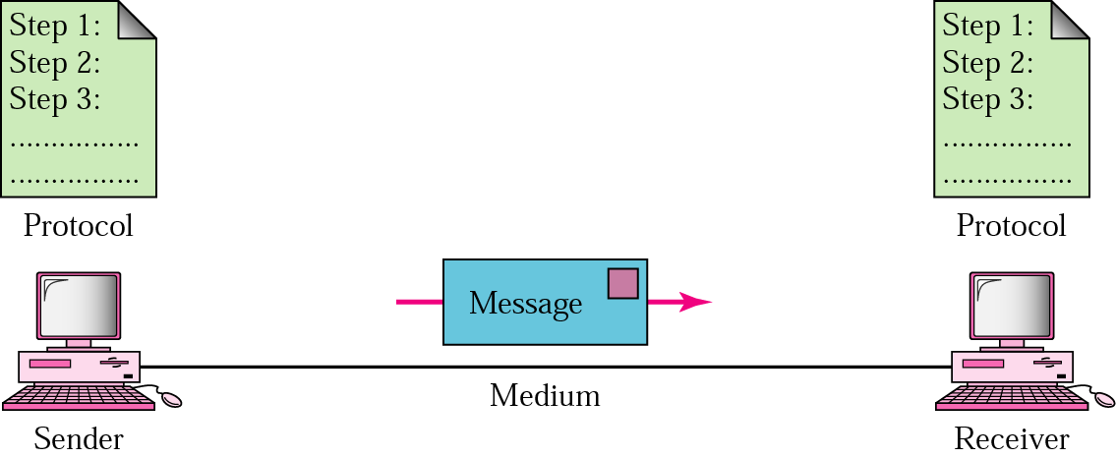
Five Components of Data Communication
Message
Sender
Receiver
Medium
Protocol

Slide 18
Communication Protocols
The procedure of data transmission in the form of software is commonly called protocol.
Data communication software is the software that enables us to communicate with other systems.
The data communication software instructs computer systems and devices as to how exactly data is to be transferred from one place to another.
Notes:
A protocol defines the format and the order of messages exchanged between
two or more communicating entities, as well as the actions taken on the transmission
and/or receipt of a message or other event.

Slide 19
Data transmission software or protocols (functions)
The data transmission software or protocols performs the following functions for the efficient and error free transmission of data
Data sequencing: A long message to be transmitted is broken into smaller packets of fixed size and a unique sequence number is given for every packet.
Data Routing: It is the process of finding the most efficient route between source and destination before sending the data.
Notes:
A protocol is synonymous with rule. It consists of a set of rules that govern data communications. It determines what is communicated, how it is communicated and when it is communicated. The key elements of a protocol are syntax, semantics and timing.

Slide 20
Cont…
Flow control: enables a receiver to regulate the flow of data from a sender so that the receiver’s buffers do not overflow. Regulates the process of sending data between fast sender and slow receiver.
Error Control: Error detecting and recovering is one of the main function of communication software. It ensures that data is transmitted without any error and loss. (retransmit if not ack.)
Opening/closing comm. Lines, message switching, circuit switching, multiple use of comm. lines, …
Transmission upon agreed encoding rules and protocols . Example is
TCP/IP; TCP/IP means Transmission Control Protocol/Internet
Protocol
Notes:
Flow control: The sending station must not send frames at a rate faster than the receiving station can absorb them.
Error control: Bit errors introduced by the transmission system should be corrected.
Compression and Encryption can also be performed by Comm. Software.
Flow control makes sure that neither side of a connection overwhelms the other side by sending too many packets too fast.
End systems are alerted to the existence of severe congestion when they stop receiving acknowledgments for the packets they have sent.

Slide 21
Elements of a Protocol (Communications Software)
Syntax
Structure or format of the data blocks
Indicates how to read the bits - field delineation
Semantics
Interprets the meaning of the bits
Knows which fields define what action
Control information for coordination and error handling
Timing
When data should be sent and what
Speed at which data should be sent or speed at which it is being received.
Notes:
Delineate: to describe or explain something in detail.
Syntax: Concerns the format of the data blocks
Semantics: Includes control information for coordination and error handling
Timing: Includes speed matching and sequencing

Slide 22
We can group protocol functions into the following categories:
• Encapsulation (data + control information)
• Fragmentation and reassembly
• Connection control
• Ordered delivery
• Flow control
• Error control
• Addressing
• Multiplexing
• Transmission services (encryption, compression,…)
Notes:
The addition of control information to data is referred to as encapsulation.

Slide 23
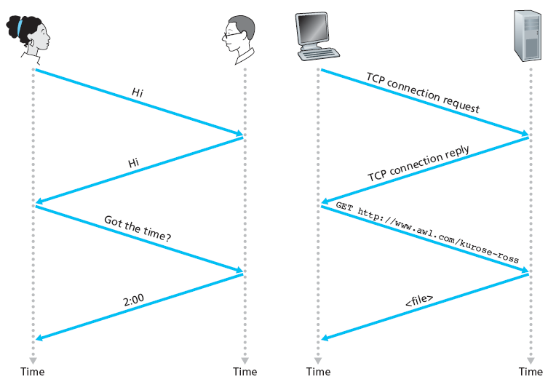
A human protocol and a computer network protocol
Notes:
Protocol: Procedure for proper communication!

Slide 24
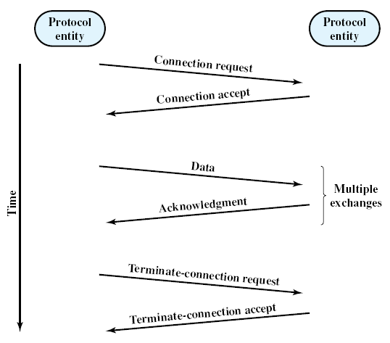
The Parts of a Connection-Oriented Data Transfer
Connection control function of a protocol

Slide 25
Data Transmission Modes
Simplex System
You can only send data from one location to another but you cannot receive. It is one way communication.
Ex. Telemetry, Broadcast radio
Half Duplex
You can send/receive but not simultaneously.
Ex. Marine Radio, Walky-talky (Police Radio)
Full Duplex
A system that allows communication in both directions simultaneously and synchronously. Use of full-duplex line improves efficiency.
The medium is carrying signals in both directions at the same time.
Ex. Telephone
Notes:
Telemetry: Transmit (readings) to a distant receiving set or station.

Slide 26
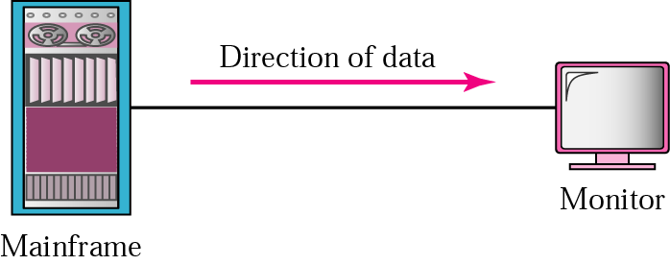
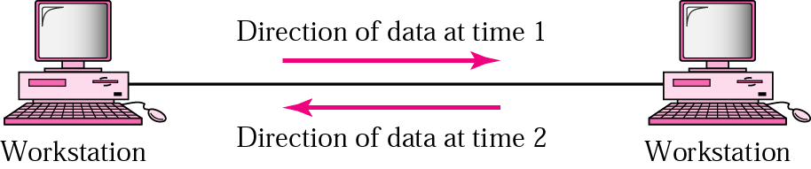
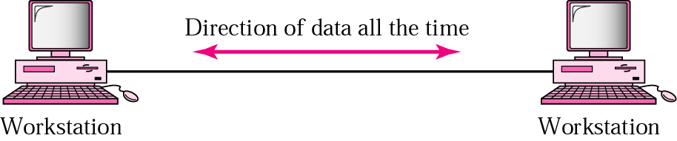
Direction of data flow
Simplex
Half Duplex
Full Duplex

Slide 27
Communication Channels
A channel is a path between two communication devices
Channel capacity: How much data can be passed through the channel (bits/sec or hz(frequency-range))
Also called channel bandwidth (range of frequencies)
The smaller the pipe the slower the data transfer!
Analog bandwidth of a medium is expressed in hertz;
Digital bandwidth of a medium is expressed in bits per second.
Consists of one or more transmission media
Materials carrying the signal
Two types:
Physical: wire or cable (Guided)
Wireless: air (or space) (Unguided)

Slide 28
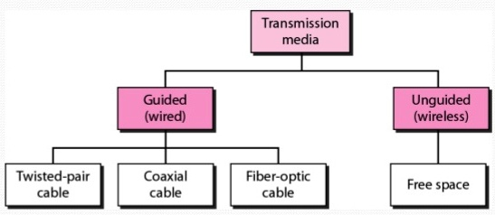
Transmission Channel (Media)
Two main categories:
Guided (Physical)
Twisted-Pair cables:
Unshielded Twisted-Pair (UTP) cables
Shielded Twisted-Pair (STP) cables
Coaxial cables
Fiber-optic cables
Unguided (Wireless)
Wireless transmission, e.g. radio, microwave, infrared, sound, sonar (echolocation finding in air and water)
Notes:
Unguided transmission is propagation through air, vacuum, and seawater.
Sonar= The method of echolocation finding in air and water!

Slide 29
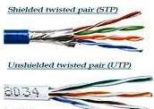
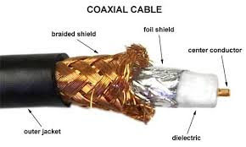
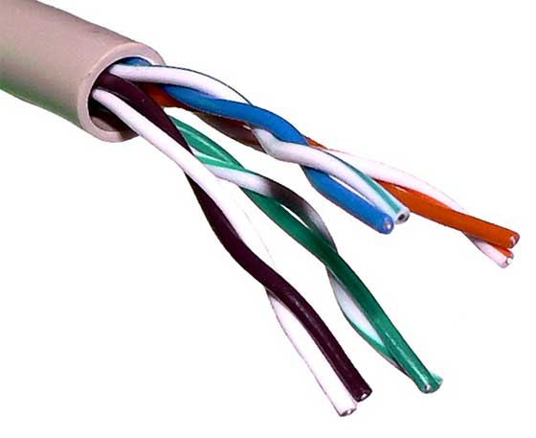
Physical Media (Guided Channel)
A tangible media
Twisted-pair cable:
One or more twisted wires bundled together (why twist?)
Made of copper
Coax-Cable:
Consists of single copper wire surrounded by three layers of insulating and metal materials
Typically used for cable TV
Fiber-optics:
Strands of glass or plastic used to transmit light
Very high capacity, low noise, small size, less suitable to natural disturbances
UTP

Slide 30
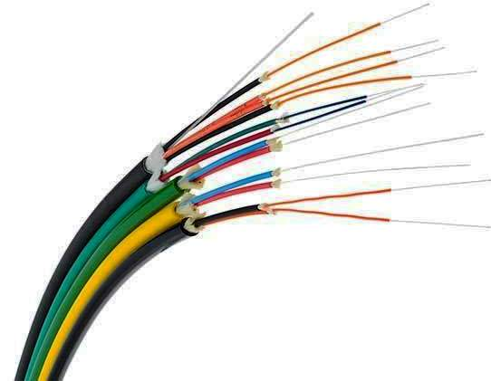
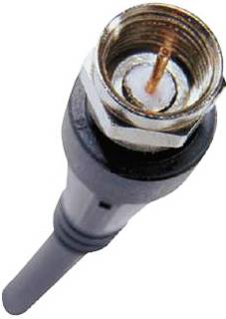

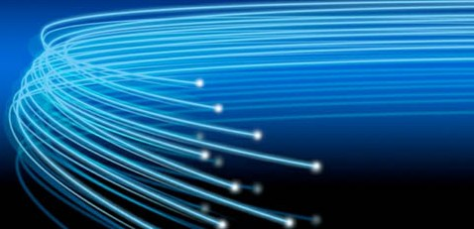
Information channel Cont’d …
Guided
Cable transmission (Attenuation, Distortion & noise) (reduce the strength & change the form during transmission) (*AC at very high voltage to overcome loss due to resistance of wire)
Fibre-optics
10GBPS and greater, long distance
Coaxial
10MBPS, 200M - 1KM
Twisted pair (Shielded Twisted Pair – STP - Cable)
10 to 1000MBPS, 100M
Twisted pair (unshielded twisted pair-UTP)
less interference protection and lower data rate than STP
Cross talk problem
Coaxial cable connector
Fiber optic cables
Notes:
Thermal noise and cross talk are two types of noises.
Attenuation=reduce the strength due to long distance transmission
Distortion=change the form during transmission

Slide 31
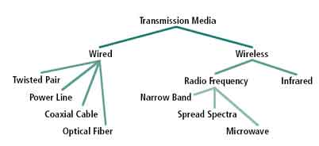
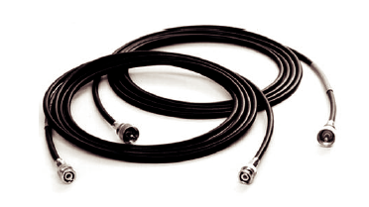
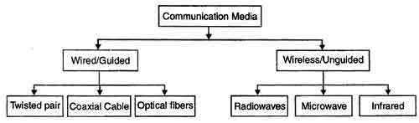
Coaxial Cable
Information channel or media Cont’d …
A thinnet coaxial cable.
Notes:
Power-line communication (PLC) is a communication method that uses electrical wiring to simultaneously carry both data and electric power. It is also known as power-line carrier, power-line digital subscriber line (PDSL), mains communication, power-line telecommunications, or power-line networking (PLN).

Slide 32
Fiber-Optic Cable
Fiber-optic cables use light signals for data transmission.
Either laser or other light producing mechanism, such as light emitting diodes (LEDs), are used as the source of light.
Using a laser is more dependable, but more costly, so most fiber-optic networks use LEDs as the source of light.

Slide 33
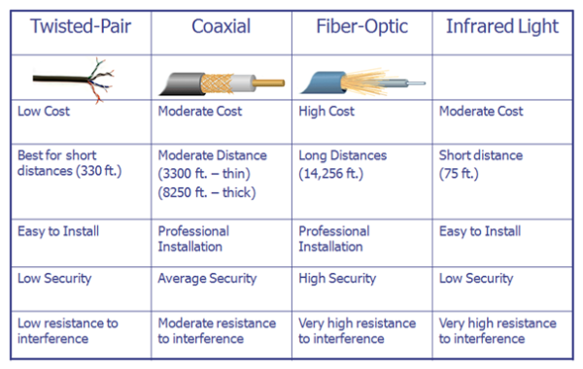
Physical Transmission Media and wireless Infrared
Characteristics Comparison
Wireless
Notes:
1 foot = 30.48 cm

Slide 34
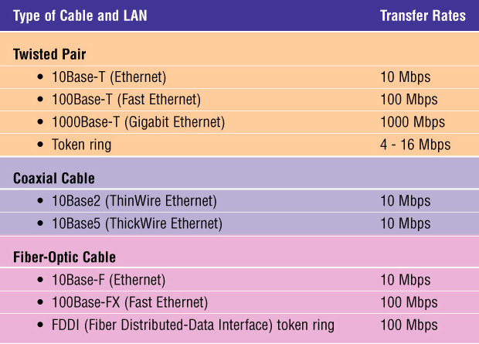
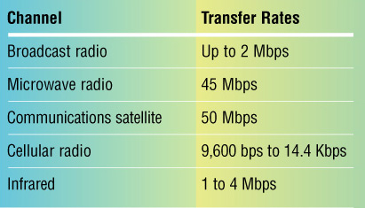
Transmission Media Data Transmission Rate
Wireless channel capacity:
Notes:
Ethernet: Network Protocol, CSMA/CD: Carrier Sense, Multiple Access, with Collision Detect. Simple rules!

Slide 35
Communication Satellite
A communication satellite is a microwave relay station placed in outer space.
In satellite communication, microwave signal is transmitted from a transmitter on earth to the satellite at space.
The satellite amplifies the weak signal and transmits it back to the receiver.
The main advantage of satellite communication is that it is a single microwave relay station visible from any point of a very large area.

Slide 36
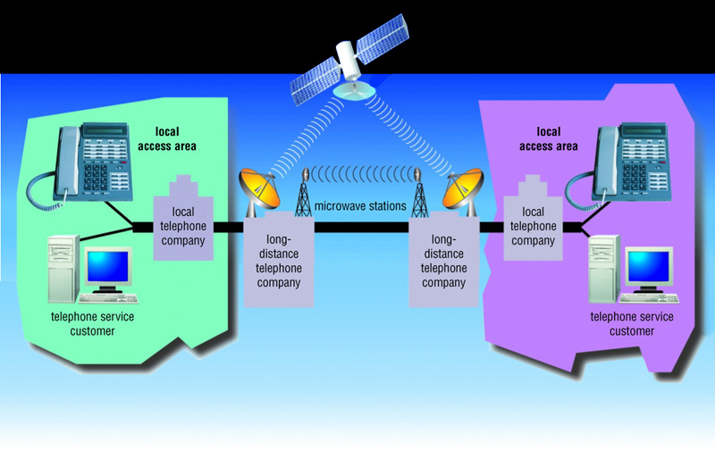
Microwave Communications Example: For Telephone Networks

Slide 37
Communication Satellite Cont.
Unguided or Wireless
Microwave
Satellite (Example; GEO or Geostationary)
A man made spacecraft, about 23,000 miles (37,030 km) above the earth (speed about 10,000 km/hr?); GEO (geosynchronous earth orbiting); 3 of them are enough to cover the whole world.
500 MHZ bandwidth (analog);
The data transmission rate is 16 Giga bits per second. They are mostly used to link big metropolitan cities;
Receives analog and digital signals, amplifies the signal and retransmits back to earth.
How are satellites put into orbit?
Notes:
Escape Velocity
One mile is approximately 1.609 kilometres.

Slide 38
Microwave (Unguided)
Microwave system uses very high frequency radio signals (10Ghz-1000Ghz) to transmit data through space.
What is the speed of a radio signal?
The transmitter and receiver of a microwave system should be in line-of-sight because the radio signal cannot bend.
With microwave very long distance transmission is not possible without using repeaters (due to line of sight).
In order to overcome the problem of line of sight and power amplification of weak signals (due to attenuation), repeaters are used at intervals of 25 to 30 kilometers between the transmitting and receiving end.

Slide 39
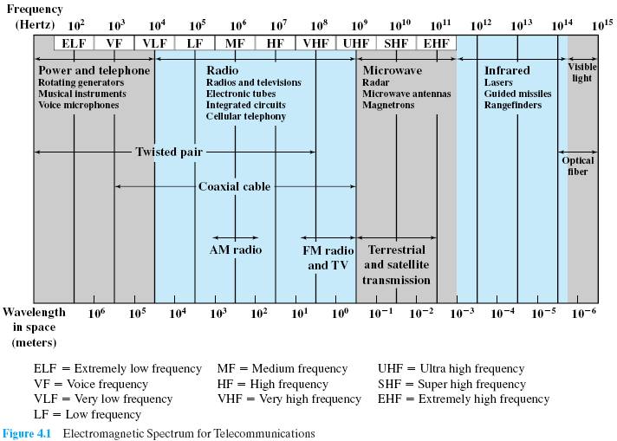
Electromagnetic Spectrum for Telecommunications

Slide 40
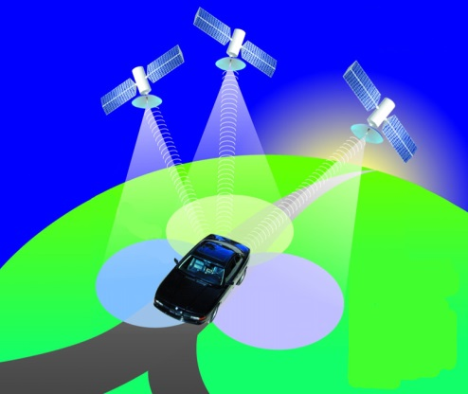
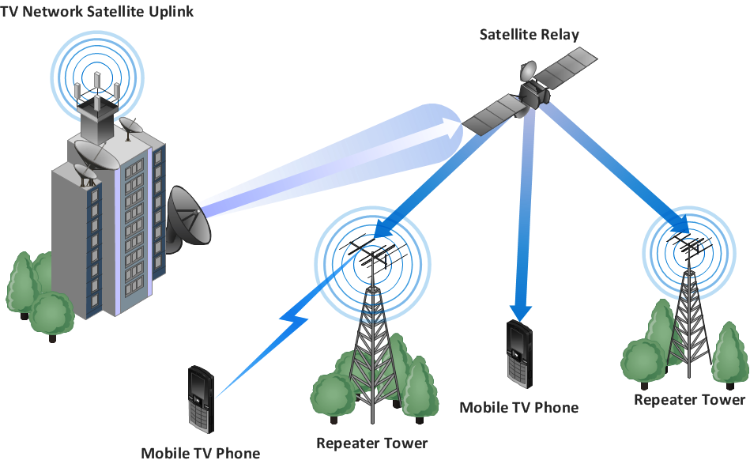
Wireless Transmission Technologies
Broadcast Radio (Example SW and AM)
Distribute signals through the air over long distance
Uses an antenna
Typically for stationary locations
Can be short range
Cellular Radio
A form of broadcast radio used for mobile communication
High frequency radio waves to transmit voice or data
Utilizes frequency-reuse
Mobile TV phone
Notes:
Non-adjacent towers (cells) can use same frequencies (reuse) in cellular radio transmission technology.
Short Wave is to Ionosphere, while AM is ground wave.

Slide 41

Wireless Transmission Cont’d…
Microwaves
Radio waves providing high speed transmission
They are point-to-point (can’t be obstructed)
Used for satellite communication
Infrared (IR)
Wireless transmission media that sends signals using infrared light- waves; 16Mbps; point-to-point
Example, electronic device remote controllers
Bluetooth: envisioned for a cable-free world
Radio frequency technology; 2Mbps
Can pass over obstacles
Can detect other nearby Bluetooth devices
The recent Apple wireless earphones
Bluetooth operates over a short range, at low power, and at low cost.
Notes:
Bluetooth operates over a short range, at low power, and at low cost. It is essentially a low-power, short-range, low-rate “cable replacement” technology for interconnecting notebooks, peripheral devices, cellular phones, and smartphones. Bluetooth networks are sometimes referred to as wireless personal area networks (WPANs).

Slide 42
Asynchronous Versus Synchronous Transmission
Asynchronous Transmission: This method, used with most microcomputers, is also called start-stop transmission.
Data is sent one byte (or character/or packet) at a time.
Not used when very large amount of data must be sent rapidly.
Its advantage is that the data can be transmitted whenever and wherever it is convenient for the sender (store and forward delivery: message switching) and (follow a convenient rout: packet switching)
Synchronous Transmission: This method, sends data in blocks.
Start and stop bit patterns, called sync bytes, are transmitted at the beginning and end of the blocks.
This method is rarely used with microcomputers because it is more complicated and more expensive than asynchronous transmission.
Appropriate for computer systems that need to transmit very large amount of data. (live transmission)(circuit switching)
Notes:
Communication Based on Online Presence During Transmission
Asynchronous : Not existing or occurring at the same time.
Synchronous : Existing or occurring at the same time.

Slide 43
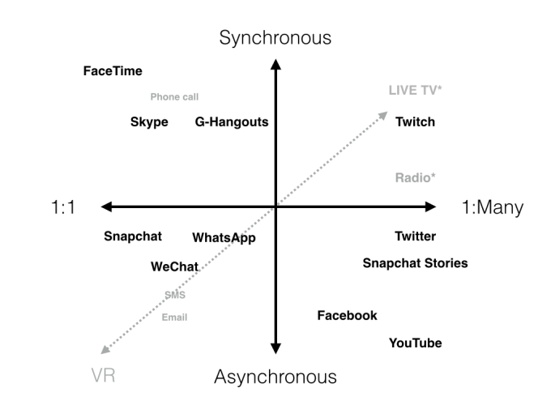
Asynchronous Versus Synchronous Cont…
Notes:
Synchronous comm. - more disciplined information exchange. Entities send a message only when it is permitted to do so. Ex. Video conference, telephone call. (Circuit switching)
Asynchronous comm. - less disciplined. Can send whenever it wishes to. Ex. Online communication, email. (message switching)
VR: Virtual Reality; Computer-generated simulation of a three-dimensional image or environment that can be interacted with in a seemingly real or physical way by a person using special electronic equipment, such as a helmet with a screen inside or gloves fitted with sensors.
Twitch is a live streaming video platform owned by Twitch Interactive, a subsidiary of Amazon.com, Inc..^{[2]} Introduced in June 2011 as a spin-off of the general-interest streaming platform Justin.tv, the site primarily focuses on video gaming, including playthroughs of video games, broadcasts of eSports competitions, creative content, and more recently, music broadcasts. Content on the site can either be viewed live or via video on demand.
WeChat : (Chinese: 微信; pinyin: Wēixìn; literally: "micro message") is a cross-platform instant messaging service developed by Tencent in China, first released in January 2011. It is one of the largest standalone messaging apps by monthly active users.
FaceTime: is Apple's video and audio calling service. Think of it as a phone that uses your Wi-Fi or cellular data connection instead of traditional phone lines. You can use it from any iPhone, iPad, iPod touch or Mac, to call anyone else using any one of those devices.

Slide 44

Applications of Data Communications
E-mail
Searchable Data (Web Sites)
E-Commerce
News Groups
Internet Telephony (VoIP)
Video Conferencing
Chat Groups
Instant Messengers
Internet Radio
Global Positioning System (GPS)
Groupware
Discussion Forums
Electronic Fund Transfer, Internet banking; Online education, Telemedicine; Online Employment or job/vacancy; Internet browsing/search engines and so on.
Notes:
E-Commerce: B2B and B2C (Alibaba, amazon) [Set of technologies and Organizations, such as banks]
Instant Messaging: Real time communication. You type hit enter, they type hit enter.

Slide 45
More on Data Communications
Requirements of Data comm.
At least two devices ready to communicate
A transmission medium
A set of rules and procedures for proper communication (protocol)
Data communications refers to the study of low-level mechanisms and technologies used to send information across a physical communication medium
Data communications provides a foundation of concepts on which the rest of networking is built
Notes:
Serial Transmission
One character at a time bits in a block of bytes
Parallel Transmission
Dedicating one line for a bit, transmitting bits at a time in parallel

Slide 46
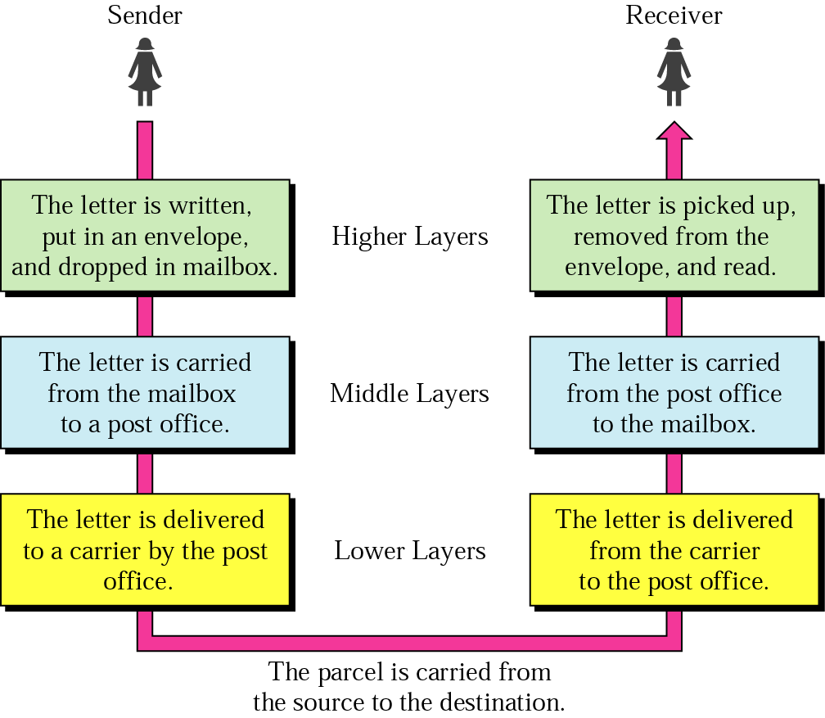
Layered Tasks in Communications
An example from the everyday life
Hierarchy of
Services
Notes:
We have other architectures for other problem domains.
Like pipes and filters, objects as in Object Orientation, repositories, interpreters, etc.

Slide 47
Why layered communication?
To reduce complexity of communication task by splitting it into several layered small tasks
Functionality of the layers can be changed as long as the service provided to the layer above stays unchanged
makes easier maintenance & updating
Each layer has its own task
Each layer has its own protocol

Slide 48
Physical Layer
What we call low level above
Specifies
the characteristics of the transmission medium
Nature of the signals
Data rate

Slide 49
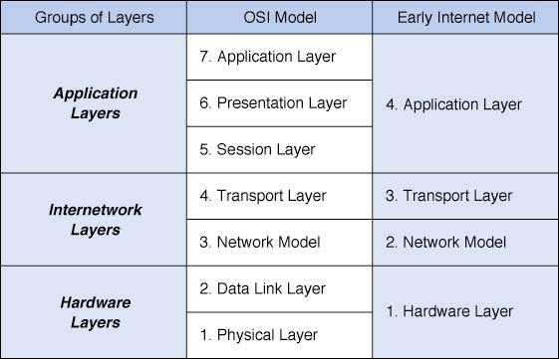
Network Models: OSI is Developed by ISO
Layer
Layer
Notes:
A model is an abstraction of complex reality. Abstraction using layering.
Each layer provides service to a layer above it.
Port number, IP address, and MAC address.
Users are uniquely identified by their session ID.
ISO = International Organization for Standardization.

Slide 50
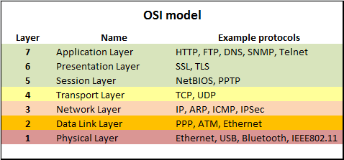
Each layer has its own protocol
Each layer provides service to a layer above it
Notes:
Transport Layer >> Segments PPP: Point to Point Protocol
Network Layer >> Packets SNMP: Simple Network Management Protocol
Data Link Layer >> Frames
Physical Layer >> Bits

Slide 51
Ethernet (example network protocol) (Hardware Layer)
CSMA/CD: Carrier Sense, Multiple Access, Collision Detect. Simple rules!
Since Ethernet was designed to be on shared media, with 2 or more users, and the “more” part can be very big (that’s the “Multiple Access” part) you have to listen to see if anyone else is talking before you talk (Carrier Sense) and if you and someone else start talking at the same time, notice it (Collision Detect), say “excuse me” stop and try again later. A polite free for all with rules.

Slide 52
Ethernet Protocol Main procedure
When one computer wanted to send some information, it followed the following algorithm
Make data ready for transmission.
Is medium idle? If not, wait for a period until it becomes ready.
Start transmitting.
Does a collision occur? If so, go to collision detected procedure (wait a couple of periods before retransmitting)
End successful transmission.

Slide 53
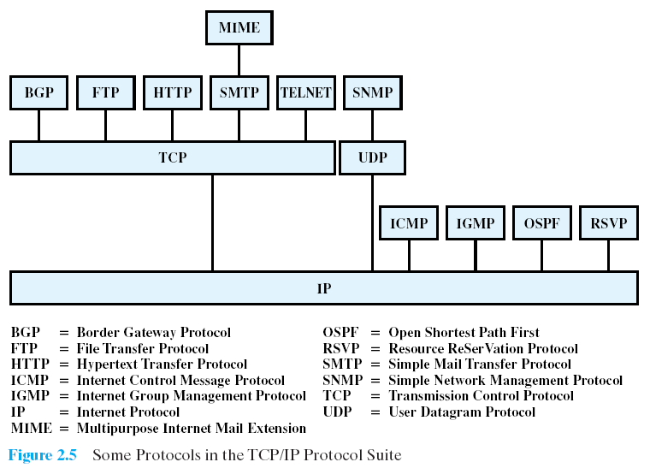
Notes:
MIME: Multipurpose internet mail extension

Slide 54
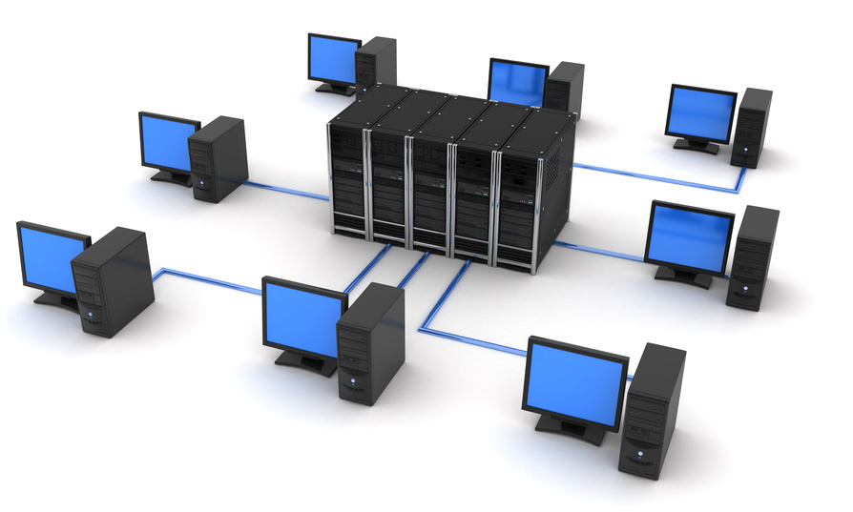
Computer Networks
A computer network is an interconnection of various computer systems located at different places.
Two or more computers and other peripheral or data communication devices linked together is called a Computer Network.
The computer that provides resources to other computers on a network is known as server.
In a network individual computers, which access shared network resources, are known as workstations or terminals or clients.

Slide 55
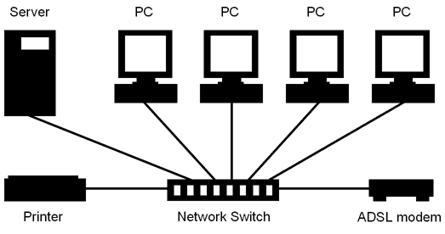
Computer Networks - Why networking?
Remote access to resources – Efficiency through accessibility
Reduction of data duplication – Data kept on a Server
Communication (Collaboration)- people can work together in ways not previously possible (ARPANET)
Notes:
ARPANET: Advanced Research Projects Agency Network
Resource Sharing: Printer and Internet Connection

Slide 56
Networks for, Cont’d …
saving money
Price / performance rate of a number of linked small computers is better than few large ones.
For example: Mainframes which are only about ten times the power of a personal computer, cost about a thousand times more.
Better to get cheaper machines and network them.
scalability - ability to grow and shrink the computer set-up
Easier to add a machine or device to a network than to add components to a mainframe.

Slide 57
use of Computer Networks ….
resource sharing
Make data, memory, programs and equipment available to everyone regardless of where they are physically. Example Printer, app server
reliability - by having alternatives
Having duplicate machines to do the processing in case one or more machine goes down, or having files mirrored on different servers so we don't depend on one machine for those files - (multiple Servers)
Notes:
Sharing Processing through running programs.

Slide 58
Networks for, Cont’d …
People use networks for
Access to remote information - for fun or information.
Banking services, marketing, online digital libraries, …
Person-to-person communication
Email, video conferencing
Interactive entertainment
Audio (music, radio, etc) and Video (movies, events, etc) on demand
Internet Access Sharing (resource sharing)

Slide 59
The Costs (Drawbacks) of Networking
Network Hardware, Software and Setup Costs
Hardware and Software Management and Administration Costs
Undesirable Sharing
Illegal or Undesirable Behavior
Data Security Concerns
Notes:
Network administrator required.

Slide 60
Different ways of classifying networks
There is no generally accepted taxonomy into which all computer networks fit, but the following dimensions standout as important:
By Network Topologies
By Transmission Technologies
By Scale
By management Method
Notes:
Transmission technologies point to point and broadcasting
Packet sent to all possible destinations - only receivers accepts - others discard
Packets can be addressed to all destinations - broadcasting
Packets can also be addressed to only a few of the possible destinations - multicasting
Normal for smaller networks - LANs
Normally, in broadcast networks, we can send to a particular machine (destination) by using the machine's address.
We also send to ALL machines by using a special agreed-on address (in broadcasting), or a set of machines, again using special addresses (in multicasting).
The reason why this type is usually only used in smaller networks is because it can generate a huge amount of unnecessary network traffic.

Slide 61
Ways of classifying networks Cont’d …
Depending on one’s perspective, we can classify networks in different ways
Based on transmission media: Wired (UTP, coaxial cables, fiber-optic cables) and Wireless
Based on network size: LAN and WAN (and MAN)
Based on management method: Peer-to-peer or Client/Server
Based on topology (connectivity): Bus, Star, Ring …

Slide 62
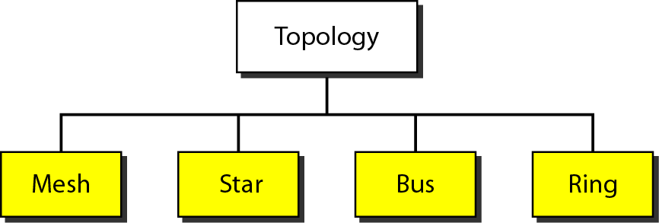
Topology of Networks
The logical layout, or shape, of a network is called topology.
Some of the basic topologies:
Star
Ring
Bus
Mesh/Complete
Notes:
Topology: Physical (geometric or shape) arrangement of computers in a network.

Slide 63
Topology Concerns
Performance issues
Reliability, Ability to recover through/after failure of one or more nodes
Physical constraints
Transmission speed, distance between nodes,
Other issues
Susceptibility / Vulnerability to errors
Growth of the network
Capability and types of equipment the network needs
Cost, geographical area

Slide 64
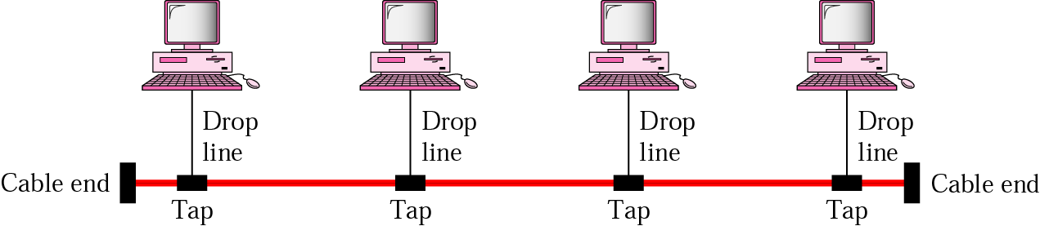
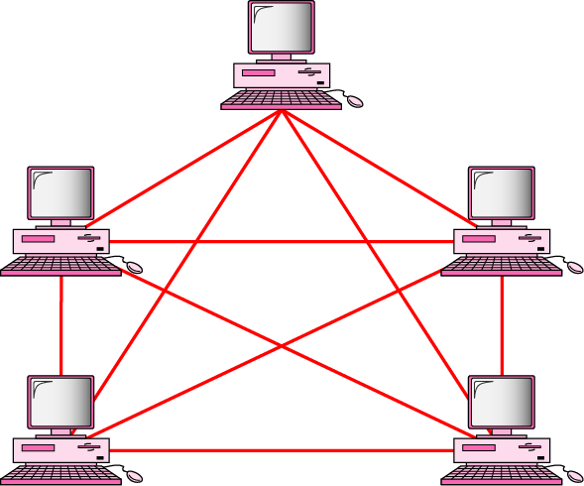
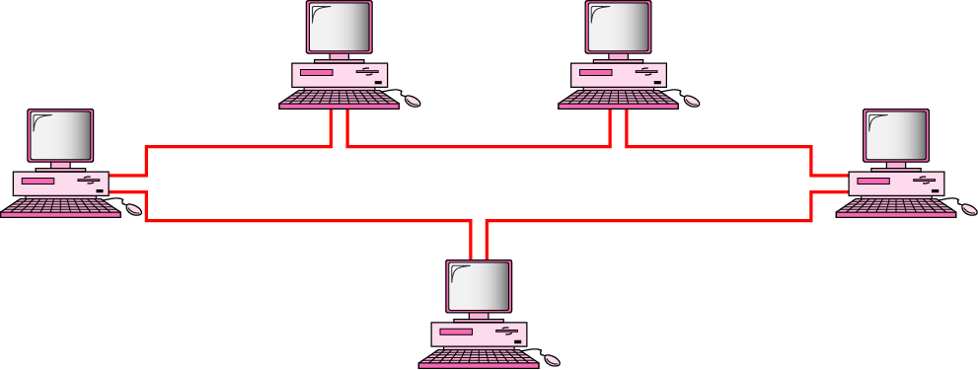
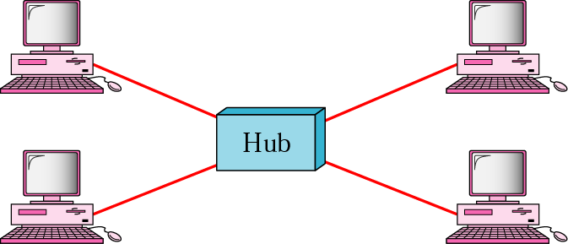
Mostly used network topologies
bus
mesh
ring
Star (Most Commonly Used Type)

Slide 65
Star Topology
A number of workstations (or nodes) are directly linked to a central node called a hub.
Any communication between stations on a star LAN must pass through the central node.
There is bi-directional communication between various nodes.
The central node controls all the activities of the nodes.
Cable segments from each computer are connected to a centralized component.

Slide 66
Cont…
The advantages of the star topology are:
It offers flexibility of adding or removing of workstations from the network.
Easy to add and remove machines, since we only need to hook them up to a central hub
Breakdown of one station does not affect any other device on the network.
It is robust since no machine depends on other machines.

Slide 67
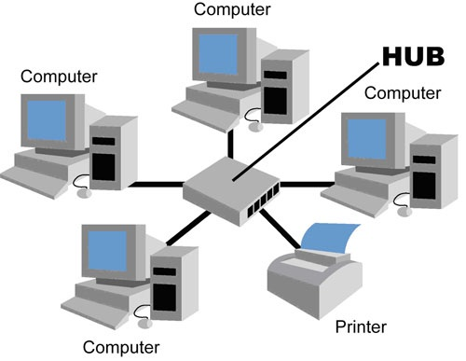
Cont…
The major disadvantage of star topology is that
Failure of the central node disables communication throughout the whole network.
It requires relatively more cabling than the Bus or Ring.

Slide 68
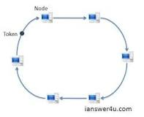
Ring Topology
Each station is attached to a nearby stations on a point to point basis so that the entire system is in the form of a Ring.
Data is transmitted mostly in one direction only or in recent designs both directions.
Thus the data packets circulate along the ring in either clockwise or anti-clockwise uni-direction in a closed loop and passes through each computer.
The failure of one computer can take down the entire network.
If a node goes down entire network goes down (single point of failure).

Slide 69
Token Ring
A ring topology is easy to install, but uses expensive parts. It is easy to add a new machine.
Token Ring Networks
Electronic token travels around the circuit
If Token is empty then data can be loaded and then offloaded at the destination node
Reduced or no chances of collision as compared to Star and Bus
An example is IBM’s token ring network

Slide 70
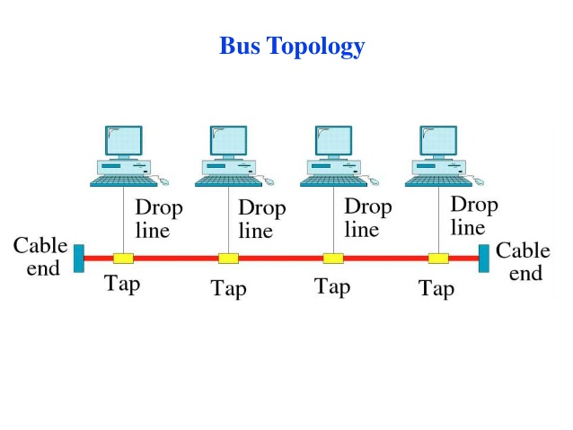

Slide 71
Bus Topology
In bus topology all workstations are connected to a single communication line called bus.
In this type of network topology there is no central node as in star topology.
All nodes compete for the use of the BUS

Slide 72
Bus Cont…
Transmission from any station travels the length of the bus in both directions and can be received by all workstations.
The advantage of the bus topology is that it is quite easy to set up.

Slide 73
Bus Cont…
If one station of the topology fails it does not affect the entire system.
The disadvantage of bus topology is that any break in the bus may break the entire network.
All messages are transmitted to the whole network
A bus topology is also easy and low cost to install.

Slide 74
Complete/Mesh Topology
A complete topology is very robust, since every machine has connection to every other machine, so doesn't depend on other machines.
It is more secure since we don't have to send data through intermediate machines. But the drawback is the amount of cabling that it needs.
Also, adding and configuring a new machine is very cumbersome.
Notes:
N(N-1)/2 connections

Slide 75
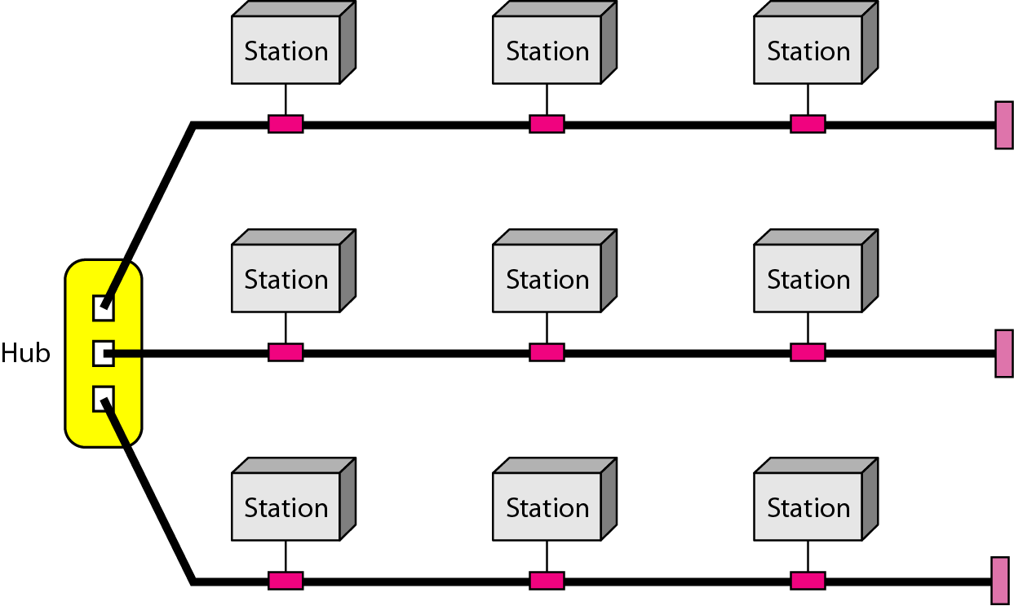
A hybrid topology: a star backbone with three bus networks
Notes:
What is a backbone? A backbone can be considered like a ring road and highway in a road network.

Slide 76
Comparison of Network topologies
Advantages and Disadvantages of Network Topologies
Topology | Advantages | Disadvantages
Bus | Cheap. Easy to install. Takes less cable | Difficult to reconfigure. Break in bus disables entire network.
Star | Cheap. Easy to install. Easy to reconfigure. Fault tolerant. Most common. | More expensive than bus.
Ring | Efficient. Easy to install. | Reconfiguration difficult. Very expensive.
Mesh | Most fault tolerant. | Reconfiguration extremely difficult. Extremely expensive. Very complex.
Notes:
Reconfiguration: Changing the setup or Moving the network somewhere

Slide 77
Network Types Based on Management Method
Two major types of networks
Peer-to-peer
Client/Server (also called server-based)

Slide 78
A Networking Lexicon
Must understand specialized networking vocabulary, including
Server — shares resources across network, typically with more central processing unit (CPU) power and storage capacity than other computers
Client — accesses shared resources
Request-response — client requests information; server responds by providing information
Client-server relationship — client makes a request to the server, and the server responds with providing requested data
Peer-to-peer — computers share and request resources from one another

Slide 79
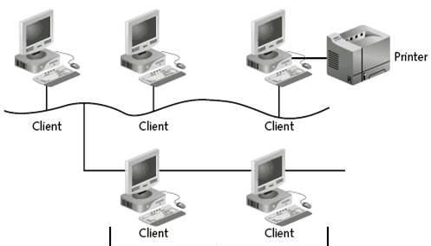
Peer-to-Peer Networking
Peers with no centralized control over shared resources
Can share resources with any other computer on network
No computer has higher access priority
No computer has more responsibility to provide or share resources

Slide 80
Peer-to-Peer Networking Advantages
Easy to install and configure
No dedicated server
Users control own shared resources
Inexpensive to purchase and operate
No additional equipment or software
No dedicated administrators
Works best with 10 or fewer peers

Slide 81
Peer-to-Peer Networking Disadvantages
Security applies to single resource at a time
Users may have many different passwords
Must back up each machine individually
Machine sharing resources may suffers reduced performance
No centralized organization scheme to locate or control access to data
Does not usually work well with more than 10 peers (users)

Slide 82


Server-Based Networks
Server responds to client requests
Provide centralized control over resources
Servers require faster CPUs, more memory, larger disk drives, and extra peripherals such as external backup storages
May be dedicated, handling only requests from client communities (file server, web server, app. server)

Slide 83
Server-Based Networks (continued)
One or more servers may do centralized verification of user accounts and passwords
Novell and Windows servers use a directory service
Checks account names and passwords against database
Manage shared resources
Windows 2000/2003/2008 calls it Active Directory
Novell NetWare calls it Novell Directory Services (NDS)
Easier to scale
May handle thousands of users

Slide 84
Server-Based Networking Advantages
Simplifies network administration
Centralizes user accounts, security, and access controls
More powerful equipment
More efficient access to network resources
Single password for network logon
Best choice for networks with 10 or more users or network with heavily-used resources

Slide 85
Server-Based Networking Disadvantages
At worst, server failure renders network unusable
At least, server failure causes loss of network resources
More expensive
Requires expert staff to handle complex server software
Requires dedicated hardware and specialized software

Slide 86
Types of Servers
File and print Servers
Application Servers
Web Servers
Database Servers
Directory Servers / Domain Controllers
Windows Servers combine computers, users, groups, and resources into logical domains
Communication Servers
Mail Servers
DHCP Server
DNS Server
Notes:
DHCP:
DNS:

Slide 87
Comparison of …
 | Peer-to-peer | Client/Server
Type of user | Homes and small businesses | Large corporations, schools, and hospitals
Size of organization | Limited number of workstations | Large number of workstations
Administration | User | Central administrator
Security | Individual users | Network administrator
Network traffic | Limited number of users | Large number of users
Cost | Inexpensive to implement | Usually more expensive than peer-to-peer
Scalability | Limited growth | High growth projected

Slide 88
Network Classification based on Scale
Local Area Networks (LANs)
Metropolitan Area Networks (MANs)
Wide Area Networks (WANs)
Internet – The World’s Largest Network of Networks

Slide 89
Network Classification based on Scale
There is no hard and fast rule on how big a network is before it becomes a LAN, MAN or WAN.
E.g. a LAN is usually identified by either all machines using the same LAN protocol (e.g. IEEE 802.3 Ethernet), or they are machines communicating within the same organization or within 1KM area.
Notes:
It is possible to have machines on opposite parts of the world communicating over the same LAN protocol, which make them belong to a LAN. This is of course not technically good, since LAN protocols were designed for small networks.

Slide 90

Based on Scale (Network Size) Cont…
(Room, Building, Campus)
(Around a person)
Notes:
Personal area networks are wireless.

Slide 91
Local Area Networks (LANs)
Collection of interconnected computers that can share data, applications, and resources such as printers.
Computers in a LAN are separated by distances of up to a few hundred meters and are typically used in offices or across nearby university campuses.
A LAN enables the fast and effective transfer of information within a group of users and reduces operational costs.

Slide 92
Cont…
LANs are the basic building blocks of other types of larger networks.
To establish a LAN you need the minimum of two computers.
It covers the smallest geographic area next to PAN.
You can have LAN in a room or a building or in a campus.

Slide 93


Local Area Network (LAN)
Network of computers located in a single location, like a home, school, or office building
Can share connection with other LANS and with the internet

Slide 94
Setting up home networks
Two or more computers (with NIC)
Cable (UTP or STP)
Connectors(RJ-45)
Switch (or Hub)
Network operating Systems
An ISP (for Internet access)

Slide 95


Network adapter card or NIC
Prepares data from computer for network and sends through the transmission medium
Receives data from network and translates for computer

Slide 96
Securing a LAN
Password
Most common tool for restricting access
Network Manager should consider the basic features of a typical password
Setting Access Rights (For security and privacy)
Different level of access depending on the nature of the information stored
Common options are: Read only, Write, Create files, make directories, Delete files
This is one of the functions of the network operating system
Notes:
Features of a password: Password length an combination of characters used in a password.

Slide 97
Extending a LAN
To alleviate the distance limitation of LAN
Methods Available
Repeaters: (physical layer devices)
tap into the network and boost the signal
Connect two LAN segments
Repeat and amplify all signals and forward noise and collision as well

Slide 98
Repeater…
Hub
Hubs are actually multiport repeaters.
Hubs are layer 1 devices (physical layer devices).
In many cases, the difference between the two devices is the number of ports that each provides.
While a typical repeater has just two ports, a hub generally has from four to twenty-four ports
Notes:
Physical layer function. A network hub is an unsophisticated device in comparison with a switch. As a multiport repeater it works by repeating bits (symbols) received from one of its ports to all other ports.
Application Layer >> Message
Transport Layer >> Segments PPP: Point to Point Protocol
Network Layer >> Packets SNMP: Simple Network Management Protocol
Data Link Layer >> Frames
Physical Layer >> Bits

Slide 99

Cont…
The devices that are used to connect network segments include bridges, switches, routers, and gateways.

Slide 100
Cont…
Bridges:
Store frames from one LAN and sends to another.
The function of the bridge is to make intelligent decisions about whether or not to pass signals on to the next segment of a network
Slows down transmission speed and has potential for bottlenecks
Do not forward noise and collision
Uses computer MAC address (Physical address)
Bridges are layer 2 devices (Data link layer devices).
Notes:
Application Layer >> Message
Transport Layer >> Segments PPP: Point to Point Protocol
Network Layer >> Packets SNMP: Simple Network Management Protocol
Data Link Layer >> Frames
Physical Layer >> Bits

Slide 101

Three departmental LANs interconnected with a bridge.
Three collision domains.
Notes:
Three collision domains.
The network address of the three LANs should be the same.

Slide 102
Cont…
Switch
Is more intelligent than a hub
A switch is sometimes described as a multiport bridge
While a typical bridge may have just two ports linking two network segments, a switch can have multiple ports depending on how many network segments are to be linked

Slide 103
Cont…
Gateway
stores and sends packets to different networks. e.g. from a LAN to a Public network. It is located at network perimeters.
Router
Routers are responsible for routing data packets from source to destination within the LAN, and for providing connectivity to the WAN.
In order to provide these services the router must be connected to the LAN and WAN.
A router at the perimeter of a network , connecting a LAN to a WAN, is essentially a gateway.
Both are Layer 3, network layer devices (uses IP address also called logical address)

Slide 104
Metropolitan Area Networks (MANs)
Similar technology to a LAN but over a wider area (e.g. city)
Utilize microwave, optical fiber, other wires; Wired or wireless
Different communicating LANs in a city can form MAN.
MAN is a type of WAN

Slide 105

Wide Area Network (WAN)
Network over a large area like a city, a country, or multiple countries
Connects multiple LANs together
Generally utilizes different and much more expensive networking equipment than LANs
The internet is the most popular WAN (Largest WAN)

Slide 106

Key Elements of the Internet

Slide 107


Slide 108
Wide Area Networks (WANs) Cont…
The largest WAN is the Internet, a global consortium of networks linked by common communication programs and protocols (a set of established standards that enable computers to communicate with each other).
Notes:
Consortium: Grouping

Slide 109

A Wide Area Network

Slide 110

Comparing LAN, MAN, and WAN

Slide 111
Domain Name System
The domain name system (DNS) is chiefly used to translate hostnames into numeric IP addresses
DNS is an example of a distributed database
If that server can resolve the hostname, it does so
If not, that server asks another domain name server

Slide 112

Connecting to the Internet
An IP address is a sequence of numbers that uniquely identifies each computer or device connected to the Internet
A domain name is a text-based name that corresponds to the IP address
A DNS server translates the domain name into its associated IP address
IPv4 address uses 32 bits
IPv6 address uses 128 bits

Slide 113
WWW - Internet
Internet is a worldwide network of networks, linking computers to computers and other devices .
It is publicly accessible network of interconnected computer networks that transmit data by packet switching using the standard Internet Protocol (IP).
Some one can use one or all of the following Internet services:
mail (e-mail).
Telnet or remote login.
FTP or File Transfer Protocol.
The World Wide Web (WWW or "the Web")
The interlinked Web pages and other documents of WWW functions using HTML and other programming embedded within HTML that make possible hypertext. Linked by hyperlinks and URL.
Notes:
The Internet is the global system of interconnected computer networks that use the Internet protocol suite (TCP/IP) to link devices worldwide. It is a network of networks that consists of private, public, academic, business, and government networks of local to global scope, linked by a broad array of electronic, wireless, and optical networking technologies.

Slide 114
Intranet and Extranet
Intranet
Is a private network that use Internet software and TCP/IP protocols
In essence it is a private internet
Important means of application delivery
Powered by internal web server
Notes:
Uses routers to connect a number of heterogeneous LANs

Slide 115
Cont…
Extranet
Is a type of inter-organizational information system
Enables people who are located outside a company to work together with the company’s internally located employees.
Aimed to connect business partners over the internet by allowing a part of their network
It comes from extended intranet
Closed to the general public, only for selected partners.
Notes:
Main objective is to foster collaboration between business partners

Slide 116
To do list (Reading Assignment)
Read and take notes of
Internet 2, Internet 3
Next Generation Internet
Mobile Internet
Value Added Network
Semantic Web
Cloud Computing

